Slide 1
Blood Giving Sets
Pothawira Surgical Center in Salima, Malawi
Notes:
Hello my name is Darcy and my group members are Michaela, Hannah, and Jason. Today I am going to summarize our progress of the hear phase for our design project on creating blood giving sets in collaboration with Pothawira Surgical Center in Salima, Malawi.

Slide 2
Table of contents
Interview
Motivation/
Background
Needs Statement
Design Criteria
Gantt Chart
Notes:
During this presentation i will first discuss our motivation and background for the project. Then I will highlight key findings from our Interview with our community partner. After I will outline our needs statement. Following I will address the design criteria for our solution. Finally I will

Slide 3
Motivation/
Background
Notes:
To start We will first discuss the motivation and background for this project

Slide 4

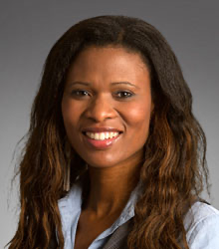
Community Partner
Partner: Pothawira (Safe Haven) Christian Mission Organisation
Founded by Dr. Anne Alaniz, a Gynecologic Oncologist who was born and raised in a neighboring village to Salima
Hope to also collaborate with engineering students and faculty at Malawi Polytechnic Institute
Photo Source: https://www.pothawira.org/people
Notes:
Our community partner is Pothawira which means Safe Haven Christian Mission Organization. Our primary contact there is the founder Dr. Anne who is a gynecologic oncologist who was born and raised in a neighboring village in Salima Malawi. Throughout this project we hope to collaborate with the engineering students and faculty at the Malawi Polytechnic Institute.

Slide 5
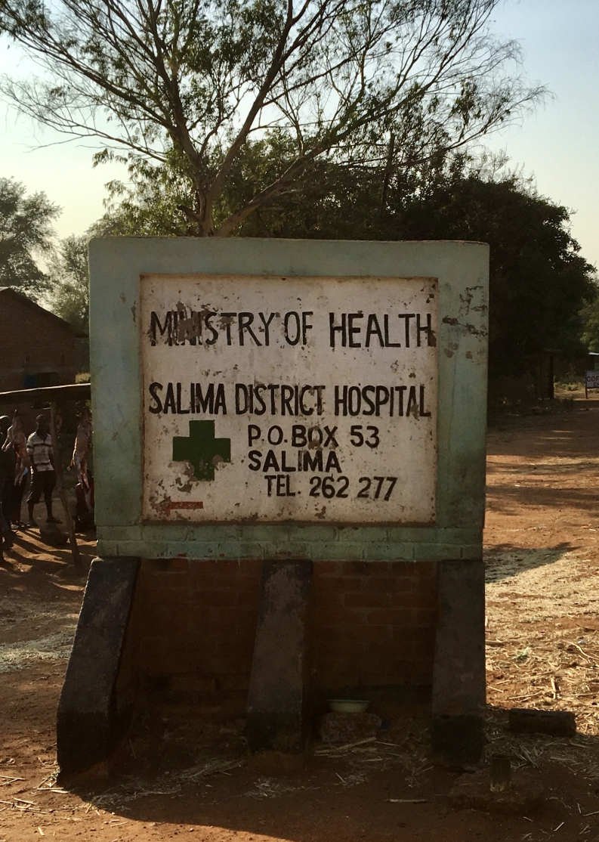
Community Location & Context
Location: Salima, Malawi
Population of Salima: ~500k
Primary Language: Chichewa
Only hospital present is Salima District Hospital
Serves population of Salima, and nearby rural areas
Faces significant accessibility and infrastructure challenges
Entrance to Salima District Hospital, taken by Hannah Kragt
Notes:
For the community location and context. The location of the new surgical ceneter and where are blood bank would be implemented is in Salima Malawi with a total population around 500 thousand. While the primary language spoken is Chickewa (cha-chay-wa), the official language is English despite it not being widely spoken
The Salima District hospital is currently the only hospital for this population. Accessibility to the hospital is not easy especially from rural areas due to poor transportation infrastructure.

Slide 6
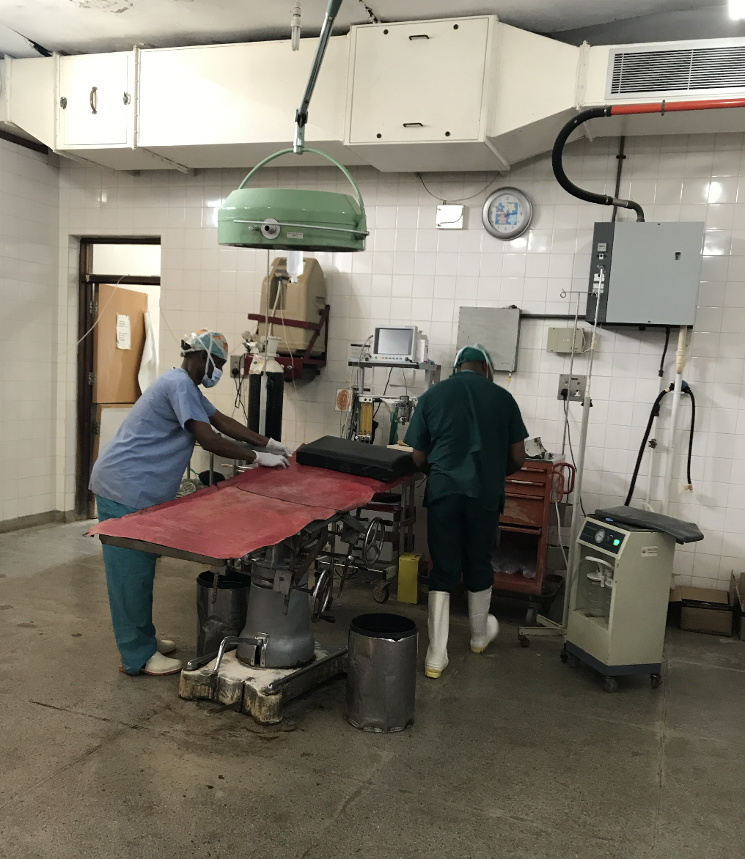
Healthcare Challenges & Historical Context
Limited transportation and infrastructure
Salima District Hospital
Accessibility is poor
Deficiency of medical supplies
Shortage of trained staff
Malawi’s healthcare history
Shaped by colonial history and post-independence underfunding
Focused more on agriculture than healthcare
Heavily reliant on external aid and shaped by donor-driven priorities
Primary OR at Salima District Hospital, taken by Hannah Kragt
Notes:
Limited transportation and infrastructure: most patients travel on foot or by bicycle to healthcare facilities.
Salima District Hospital is a regional referral center, but accessibility is poor, and there is a shortage of medical supplies and staff.
Malawi’s healthcare shaped by colonial history and post-independence underfunding, focusing more on agriculture than healthcare.
Picture shows the primary OR in the Salima District hospital

Slide 7
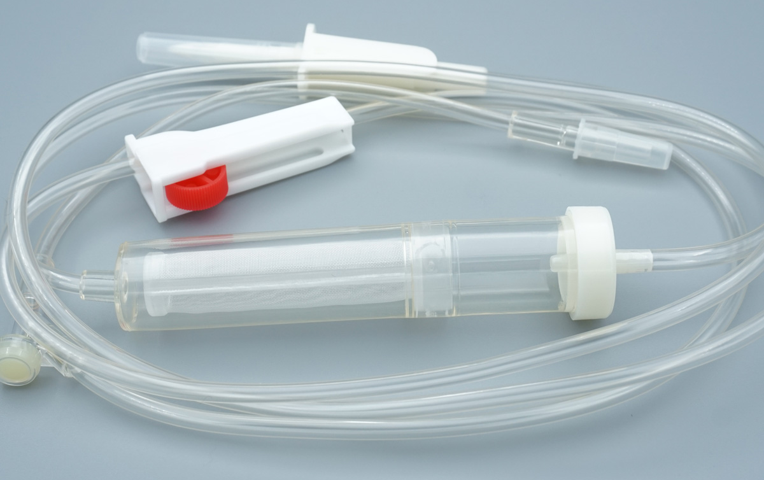
Project Motivation
Salima District Hospital
Little to no blood stored in it’s blood bank
Minimal transfusion sets provided by government
Patients must
Come with a relative sharing the same blood type
Acquire their own transfusion sets themselves
Urgent need for reusable sterilizable blood-giving sets so patients are able to acquire a blood transfusion when needed
Photo Source: https://www.kohope.com/products/transfusion-sets/
Notes:
The Salima District Hospital has little to no blood stored in it’s blood bank and minimal transfusion sets provided by government
Patients must come with a relative sharting the same blood type
If no transfusion sets are available, patients’ families must also acquire these themselves, resulting in fatal delays if no sets are available
Urgent need for reusable, sterilizable blood-giving sets to treat patients, particularly for postpartum hemorrhage, sickle cell anemia, and pediatric malaria.

Slide 8
Interview
Notes:
Next for the hear phase we conducted an interview with out community partners Dr. Anne and Dr. Joanie both surgeons who have worked at this hospital in Malawi and both play a crucial role in the Pothawira Organization and the implementation of the new hospital

Slide 9
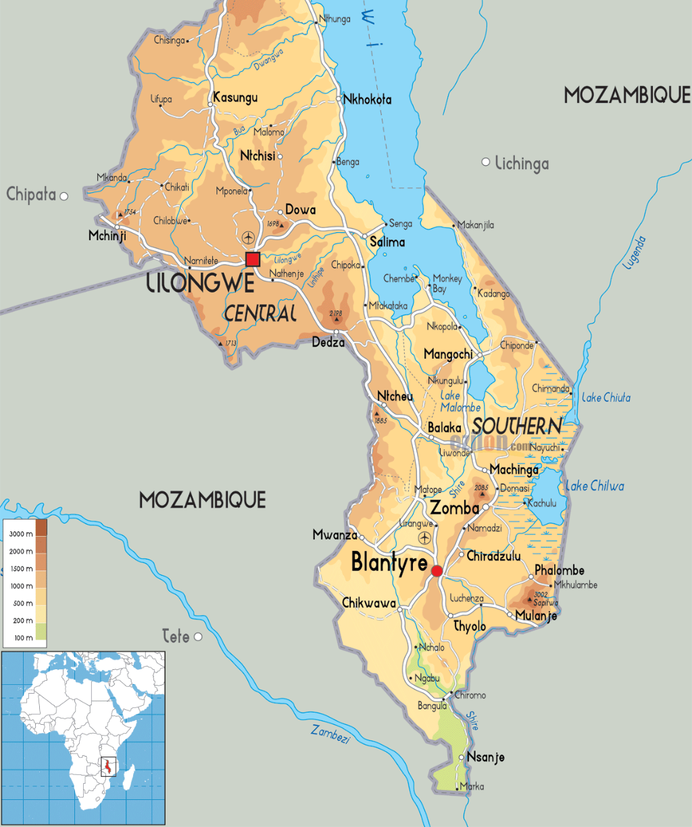
Context and Founding
Dr. Anne grew up in Salima, Malawi
Worked in clinic
Difference in care compared to the US
Women giving birth on the floor, postpartum hemorrhages (PPH)
Travel 2 hours to get blood giving set from capital
Only receive 10L of blood per week from Capital
Only lasts 24 hours
Blood is very sacred
2 hours
Notes:
For the first part of the interview we wanted to gain a deeper understanding of context and founding of the organization and clinic.
The clinic was founded in 2008
Dr. Anne grew up in a town close to Salima Malawi. She splits her time between Texas and malawi now and emphasized the difference in care compared to the US
She told many sad stories of the difference in care and why this project would greatly improve patients care at the clinic, including…
women having babies on the floor, on trash bags, having postpartum hemorrhages with no way of getting assistance
With the majority of pregnancies being adolencents
Have seen many cases where people will travel with their relatives to the clinic to get treatment, they won't have any giving sets at the clinic, the relative will travel up to 2 hours to the capital of Lilongwe to get a set, and come back prepared to donate their blood only to encounter that their relative has already passed away from lack of blood.
Additionally blood is sacred, making it hard to get donations for people that dont have a family and then they have no way of storing it

Slide 10
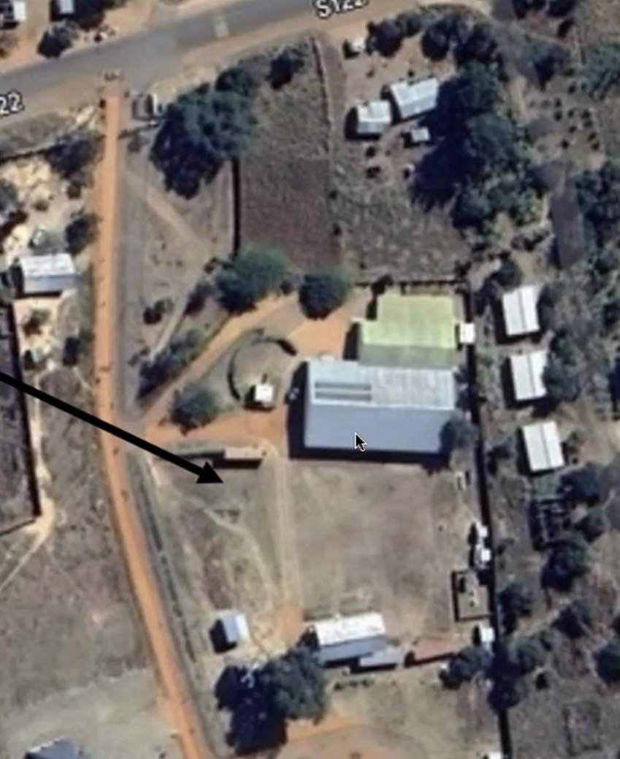
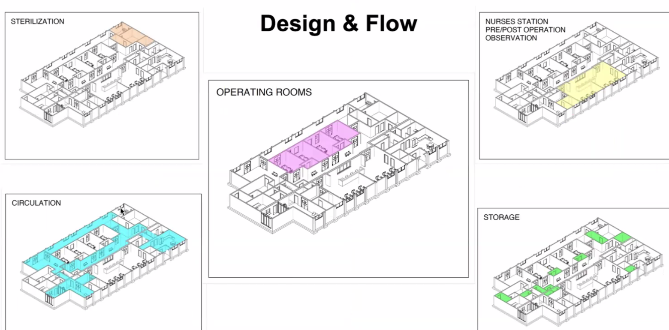
Location Setup
autoclave here
aerial view of clinic
blood bank here
Notes:
Dr. Joanie provided additional background to the surgical center currently being built, specifically location set up
This gave us knowledge about where our product is going to go, storage capacity and mobility
As well as context for the place these people are working in and how the facility will function
And gives us a better understanding of the people there and what medical care they have access to

Slide 11
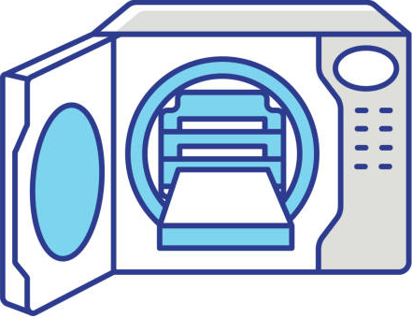

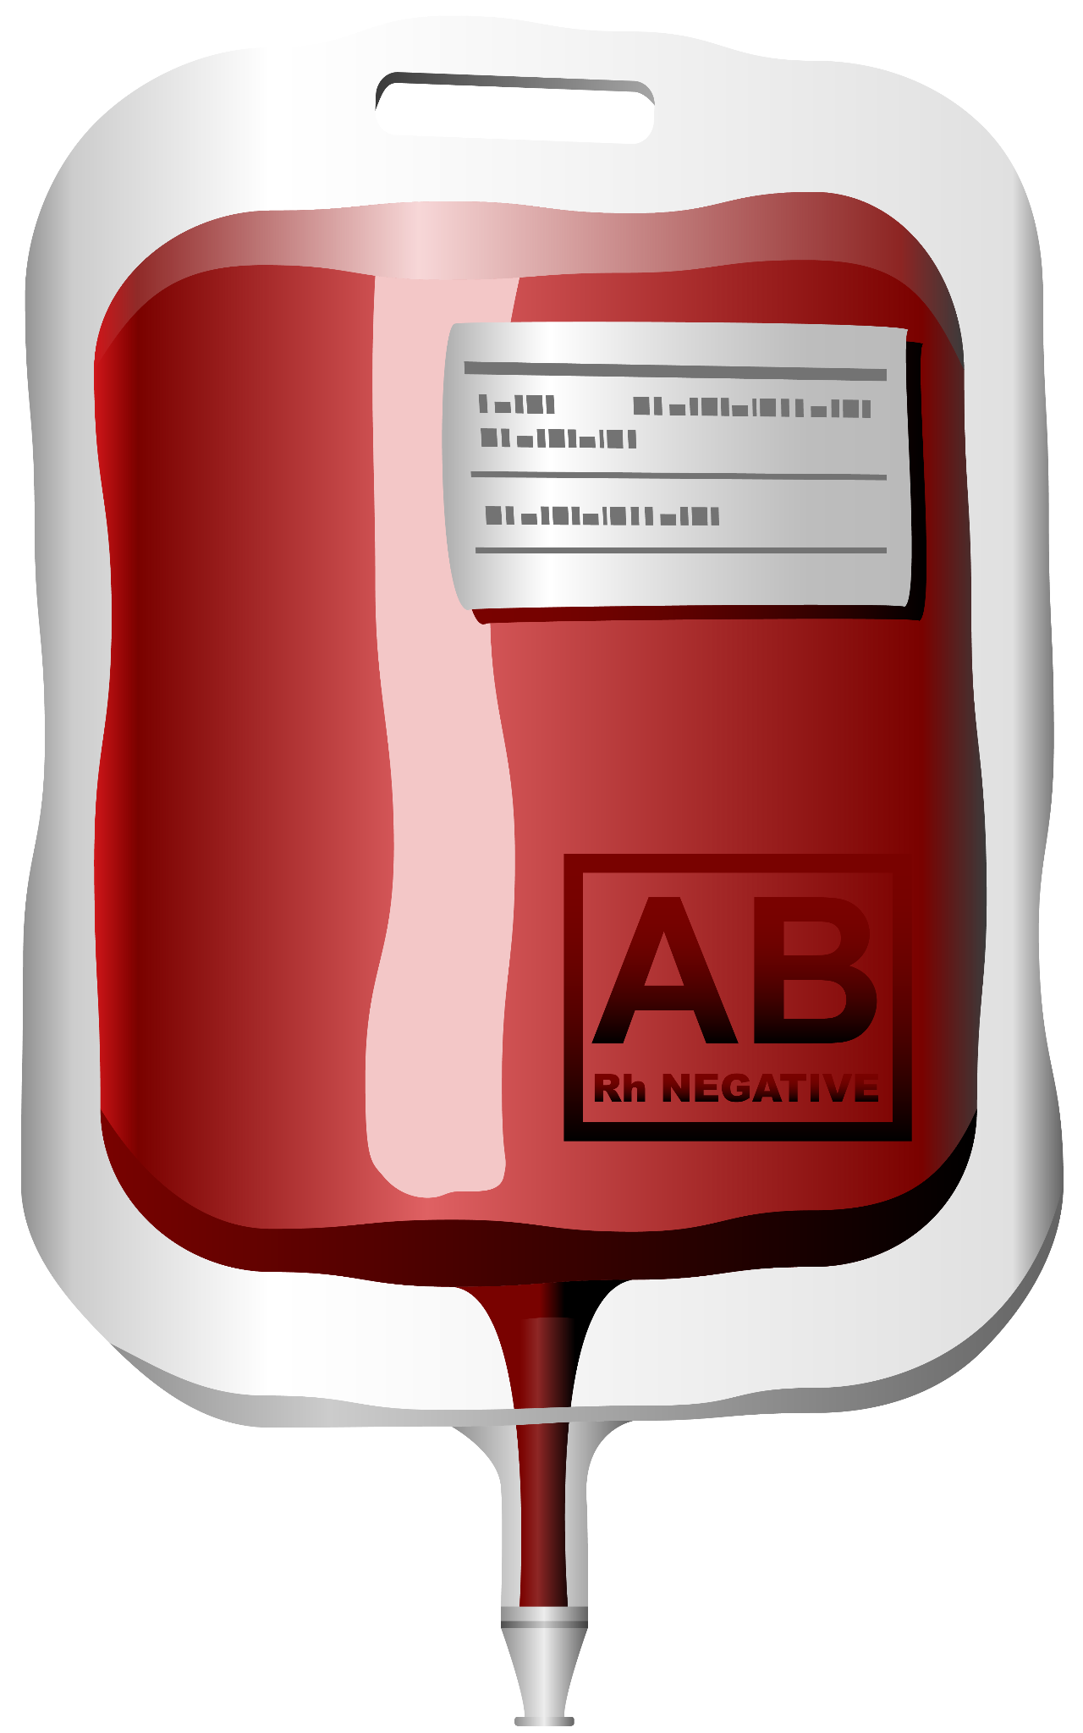
Informing Design Criteria
Need 24 units of blood daily
~48 blood bags used daily
Autoclave for sterilization
132 ^{º}C
Store in fridge
Withstand cooler temps
Easy to use for staff
Notes:
At the end of the interview we wanted to get an understanding of our design criteria from our community partners POV. The main takeaways were..
The clinic needs 24 units of blood daily which would be about 48 blood bags used daily
The device must be autoclavable for sterilization which would be at a temperature for 132 degrees
It also must be able to withstand cooler temperature during fridge storage
And the last major design criteria they touched on was to have device be easy to use for the clinic staff

Slide 12
Needs Statement
Notes:
After our interview with Dr. Anne and Dr. Joanie and our background research we were able to construct our needs statement for the project

Slide 13
Needs Statement
The Pothawira Surgical Center in Salima, Malawi needs a method for affordable, reusable, and sterilizable blood-giving sets and a blood-warming device that can safely warm stored blood to the optimal transfusion temperature
Notes:
The Pothawira Surgical Center in Salima, Malawi needs a method for affordable, reusable, and sterilizable blood-giving sets and a blood-warming device that can safely warm stored blood to the optimal transfusion temperature

Slide 14
Design Criteria
Notes:
Our next step was to define our design criteria for our project…

Slide 15
Design Criteria (Must Haves)
Sterilizable
Resource Availability
Air-tight Seal
Reusability
Temperature Maintenance
Mechanical Robustness
Metric: Withstand sterilization in autoclave
Test: 50 cycles of autoclaving
Metric: Locally sourced materials
Test: Verify availability in Malawi
Metric: No contamination or leaks
Test: Water/air pressure and vacuum tests
Metric: Withstands 200 uses
Test: Repeated sterilization and assembly
Metric: Maintain 36°C±4°C
Test: 5-minute saline temperature check
Metric: Withstands rough handling
Test: Drop and impact resistance tests
Notes:
First we identified 6 must haves for our device.
Our device must be sterilizable and withstand sterilization and temperatures of an autoclave.
We plan to test this by putting our device through 50 cycles of an autoclave machine
It must also be made from locally sourced materials
We will be in contact with engineerings students at the Malawi polytechnic institute to verify the accessibility of the materials we chose to use
Additionally it must be air-tight with no contamination or leaks.
We plan to test this by performing water and or air pressure and vacuum tests
Our device must be reusable and withstand 200 uses
We will confirm this by performing repeated sterilization and assembly
It must also maintain a temperature between 32 and 40 degrees celsius
To test this we will do a 5 minute saline temperature check
Our last must have for our design is it must be mechanically robust and withstand rough handling
To test this design criteria we will perform drop and impact resistance tests.

Slide 16
Design Criteria (Nice to Haves)
Cost
Ease of Use
Energy Efficiency
Compact Design
Metric: <$100 for sets, <$300 for warmer
Test: Material and labor cost analysis
Metric: <2 kg, setup in 10 mins
Test: Usability tests
Metric: <50W power consumption
Test: Power meter during use
Metric: Comparable to blood bags
Test: Dimension fit in clinical storage
Notes:
We also identified 4 design criteria that would be nice to have…
First it would be nice for the transfusion sets to cost less than $100 and the blood warmer to cost less than $300.
To verify this we will perform a material and labor cost analysis
Second, it would be nice for our device to be easy to use, ideally lightweight and quick to set up
We will do usability tests to check this criteria
Third, having our warmer device be energy efficient and use less than 50 watts of power during use.
To test this we will measure the power during use
Fourth, we want our deign to be compact and comparable to current blood bags
To verify this we will check dimension fit in clinical storage.

Slide 17
Gantt Chart
Notes:
An important part of our planning for the semester has taken place on our gantt Chart…

Slide 18
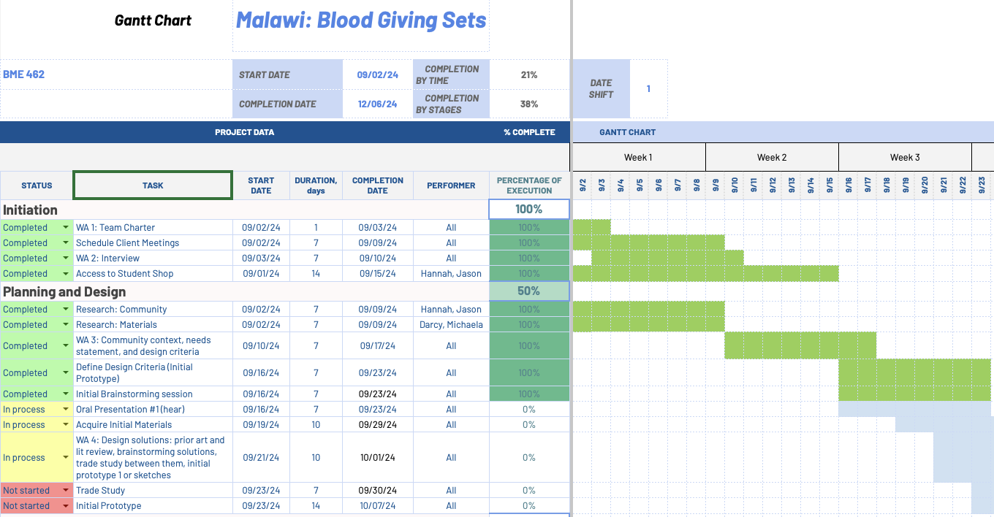
Link
Notes:
Here is our Gantt chart for our project. This gives an initial overview of what we have accomplished so far, and for the full chart let me jump to our spreadsheet.
Here is our overall planning breakdown for the project, we have separated it into 5 main sections: Initiation, Planning and design, Execution, Finalization and handoff and final presentation.
So far we have completed the tasks in the initiation stage of our design and our in the process of the planning and implementation.
The chart has helped improved time management and understanding of the bigger picture and timeline for the semester.
We are excited to continue working on this project this semester…

Slide 19
Next Steps
Continued Research
Brainstorming
Trade Study
Initial Solution
Notes:
Looking forward to the next steps, we have four main ones in mind: Continued research, brainstorming, trade study, and initial solution.
For Continued Research
We plan to continuing researching materials
As well as interview more people involved in this process such as nurses who perform blood transfusions during surgery and engineering students at the Malawi Polytechnic institute
Next for our Brainstorming
We plan to begin the processes with individual brainstorming to try to get as many unique ideas as possible
And then combine our ideas together as a group
Trade Study
From our brainstorming sessions we plan to conduct multiple trade studies for our design from our brainstorming sessions. Weighting each of our design criteria previously established to create helpful design matrices
Then for our Initial Solution
We plan to use the information we have gathered in these previous next steps we plan to start designing our initial solution as a low fidelity prototype
Thank you! Any questions?

Slide 20
Blood Giving Sets
Pothawira Surgical Center in Salima, Malawi
Notes:
Hello my name is Darcy and my group members are Michaela, Hannah, and Jason. Today I am going to summarize our progress of the hear phase for our design project on creating blood giving sets in collaboration with Pothawira Surgical Center in Salima, Malawi.

Slide 21
References
G. A. Abiiro, G. B. Mbera, and M. De Allegri, "Gaps in universal health coverage in Malawi: A qualitative study in rural communities," BMC Health Serv. Res., vol. 14, p. 234, 2014. [Online]. Available: https://doi.org/10.1186/1472-6963-14-234
Malawi Project, "Inside the Salima District Hospital—A Tier Two Facility," Malawi Project, Aug. 24, 2007. [Online]. Available: https://www.malawiproject.org/inside-the-salima-district-hospital-a-tier-two-facility/

